Slide 1

50.051 Programming Language Concepts W8-S1 Introduction to Compilers
Matthieu De Mari

Slide 2
Compiler: a definition
Program in a given language (source language)
Definition (Compilers): Compilers are computer programs whose purpose is to
Translate a program written in one language (called source language),
Into a program written in another language (called target language).
Target language is often machine code or bytecode.
Compiler
Program in another language
(target language, often machine code, or bytecode)

Slide 3
Compiler: a definition
Definition (Compilers): Compilers are computer programs whose purpose is to
Translate a program written in one language (called source language),
Into a program written in another language (called target language).
Target language is often machine code or bytecode.
The purpose of compilers is then
To check if the code to be compiled is valid,
To automate the translation process, which will eventually allow for a given code from a given programming language to be translated into machine code,
And eventually executed by the CPU of your computer.

Slide 4
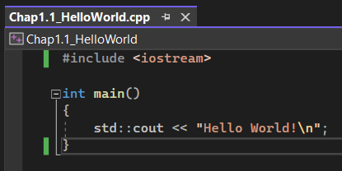
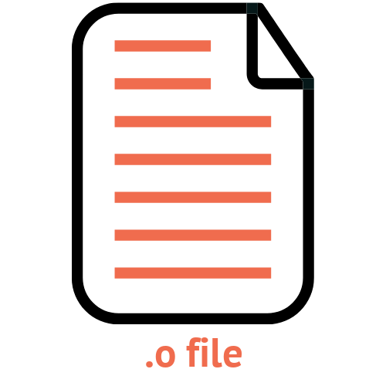

Compiler: a definition
Definition (Source Program and Target Program):
Typically, compilers will translate
A source program often written in a high-level language (e.g. C/C++),
Into a target program often written in a low-level language (e.g. machine code, ready to be executed by the CPU).
Compilers will typically prepare our source code for execution.
Source Program (C/C++)
Compiler
Target Program
(Object Code)
Execution

Slide 5
What does a compiler need?
Definition (Conceptual Roadmap of a Compiler):
Translating software from one language to another language requires to:
Understand form/syntax of the source code and the rules that govern form/syntax in the source language,
Understand the content/meaning of the source code and source language,
Understand the rules that govern form/syntax and content/meaning of the target language,
Have a scheme for mapping content/meaning from the source language to the target language.
This defines a basic conceptual roadmap of a compiler.

Slide 6
On the need of intermediate languages (IL) or intermediate representations (IR)
Definition (Intermediate Language (IL), Intermediate Representation (IR)):
It might be tempting to think compilers are black-boxes capable of translating a source program directly into CPU instructions.
In practice, we prefer to add extra steps to the translation, typically translating the source program into an Intermediate Language (IL), first.
This Intermediate Representation (IR), often has a lower language level, than the source code, and will then be translated into our target program.
This typically allows for optimization routines to be run on the intermediate program before the final translation and upcoming execution (For instance, checking for errors and optimizing your computer resources).

Slide 7

Compiler #1
(C/C++ to IL)
Source Program (C/C++)
Intermediate Language Code
Compiler
Some extra steps, e.g. error handling, resource optimization, etc.
Target Program
(Object Code)
Compiler #2
(IL to Object Code)
Execution

Slide 8
Source-to-source compilers
Definition (Source-To-Source Compilers):
C and C++ are among the most basic languages. These days, compilers for C and C++ are available on most computers and operating systems.
For this reason, many programming languages will therefore compile by using C/C++ as an intermediate language, first.
Then, all it takes is one extra compilation from C/C++ to machine code, which then leads to execution.
Compilers that target other programming languages (typically C/C++) are then commonly referred to as source-to-source compilers.

Slide 9
And interpreters in all of this?
Definition (Interpreters):
Many of you have probably heard about the compilers vs. interpreters paradigm, but what is it about?
Interpreters have the same objective as compilers, i.e. translate a source program into target code which can be executed by the CPU.
What changes is the translation and execution procedure:
Compilers will translate the source code into target code in its entirety first, and THEN will execute the target code.
Interpreters, on the other hand, will translate each line of the source code one line at a time, and execute each one of them in succession.

Slide 10
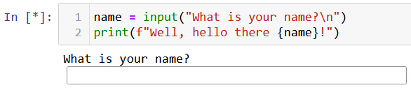



Source Program (Python)
Interpreter
…
Line 1
Line 2
Line N
Source Program (Python)
Source Program (Python)
Translate, check for errors, etc. and execute
Translate, check for errors, etc. and execute
…
Results
Results
Results

Slide 11
Compilers vs. Interpreters (to summarize)
Compilers | Interpreters
Scans the entire program and translates it as a whole into machine code. | Translates program one statement at a time.
If there is an error in the code, compilation will crash and nothing will be executed. Error message will describe the first error encountered. All or nothing. | If there is an error in the code, execution will happen until the first error is met, at which point the execution stops, making it easier to debug. Beginner-friendly.
Compilers usually take a large amount of time to analyze the source code. However, the overall execution time is comparatively faster than interpreters. | Interpreters usually take less amount of time to analyze the source code. However, the overall execution time is comparatively slower than compilers.
Programming languages like C, C++, Java use compilers. | Programming languages like JavaScript, Python, Ruby use interpreters.
Note: Implementation of interpreters are out of the scope of this class.
Discussing them for general knowledge.

Slide 12
Just-in-time compilation
Compiler
(Java to IL)
Definition (Just-in-time Compilers):
A compiler can have multiple translations in succession, using several intermediate languages before reaching target code.
In certain languages (e.g., Java), some of these successive translations are done using a combination of compilers and interpreters.
The whole compiler is then commonly referred to as a just-in-time compiler.
Note: Implementation is out-of-scope.
Intermediate Language Code
Some extra steps, e.g. error handling, resource optimization, etc.
Interpreter
(IL to Execution)

Slide 13
Just-in-time compilation
Definition (Just-in-time Compilers):
Just-in-time compilers (JIT) are then a type of compiler that
Dynamically compiles source code into machine code at runtime,
Rather than ahead of time.
This allows for greater flexibility and performance optimization, as the compiler can make use of runtime information and adjust its optimization strategies accordingly.
In some languages like Java, JIT compilation is used in combination with interpreters to achieve the benefits of both approaches.
(Basically, getting the best of both worlds?)

Slide 14
Why should you study compilers in a Computer Science degree?
A great introduction to techniques for translation and improvement of programs written in any programming language.
A fantastic practical exercise in software engineering.
Provides an understanding of what happens in the background when you press the “Run” button of your programs.
A way to understand where typical compilation errors come from.
A better understanding of the missing link between any programming course and the 50.002 Computation Structures one.
A much-needed introduction course to compilers, if one day you plan on writing your own programming language (don’t!).

Slide 15
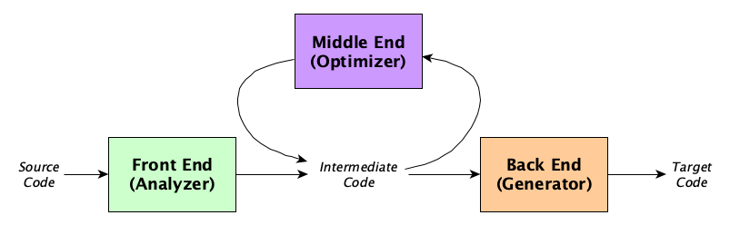
The architecture of a compiler
Definition (the three parts of a typical compiler architecture):
A typical compiler architecture consists of three main components: the front-end, middle-end, and back-end.
Each component is responsible for a specific set of tasks and works together to generate the final executable code.

Slide 16
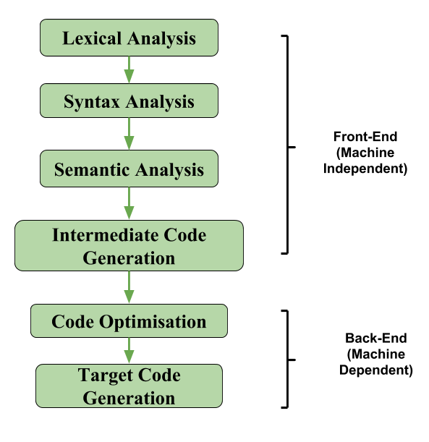
The architecture of a compiler
Definition (the three parts of a typical compiler architecture):
A typical compiler architecture consists of three main components: the front-end, (the middle-end,) and back-end.
Each component is responsible for a specific set of tasks and works together to generate the final executable code.

Slide 17
The front-end of a compiler
Definition (The front-end part of a compiler):
The front-end of a compiler is responsible for verifying the source code, eventually converting it into a form that can be used by the rest of the compiler.
It involves tasks, such as:
Lexical analysis,
Syntax analysis,
and Semantic analysis.

Slide 18
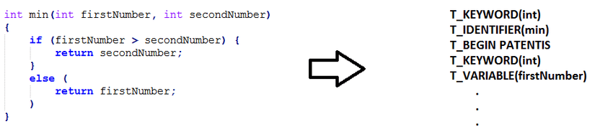
Lexical Analysis
Definition (Lexical Analysis):
During lexical analysis, the source code is broken down into tokens, which represent the individual components of the language.
It is sometimes referred to as scanning or tokenization.

Slide 19
Lexical Analysis
Definition (Tokens):
Tokens are the smallest individual units of a programming language that the compiler can recognize and understand. A token is a sequence of characters that has a specific meaning in the language, such as a keyword, identifier, operator, or punctuation symbol.
Keyword: A keyword is a reserved word in a programming language that has a special meaning and cannot be used as an identifier.
Examples of keywords in the C programming language:
int, double, long, ...
if, else, while, …
return, ...
etc.

Slide 20
Lexical Analysis
Definition (Tokens):
Tokens are the smallest individual units of a programming language that the compiler can recognize and understand. A token is a sequence of characters that has a specific meaning in the language, such as a keyword, identifier, operator, or punctuation symbol.
Identifier: An identifier is a name given to a variable, function, or other entity in a program. Will follow rules, such as starting with a letter or underscore and consisting of letters, digits, and underscores.
Examples of identifiers:
x, counter, variable_1,
myFunction,
etc.

Slide 21
Lexical Analysis
Definition (Tokens):
Tokens are the smallest individual units of a programming language that the compiler can recognize and understand. A token is a sequence of characters that has a specific meaning in the language, such as a keyword, identifier, operator, or punctuation symbol.
Literal: A value of some sort to be assigned to a variable.
Examples of literals in the C programming language:
12542
12654165.52
“hello”
Etc.

Slide 22
Lexical Analysis
Definition (Tokens):
Tokens are the smallest individual units of a programming language that the compiler can recognize and understand. A token is a sequence of characters that has a specific meaning in the language, such as a keyword, identifier, operator, or punctuation symbol.
Operator: An operator is a symbol that performs a specific operation on one or more values.
Examples of operators in the C programming language:
+, -, *, /,
=,
&&,
etc.

Slide 23
Lexical Analysis
Definition (Tokens):
Tokens are the smallest individual units of a programming language that the compiler can recognize and understand. A token is a sequence of characters that has a specific meaning in the language, such as a keyword, identifier, operator, or punctuation symbol.
Punctuation symbol: A punctuation symbol is a symbol used to separate or group different parts of a program
Examples of punctuation symbols in the C programming language
Braces {} and parentheses ()
Commas, semicolons,
Quotation marks,
Etc.

Slide 24
Lexical Analysis
Definition (Lexical Analysis):
During lexical analysis, the source code is broken down into tokens, which represent the individual components of the language.
It is sometimes referred to as scanning or tokenization.
KEYWORD (int)
IDENTIFIER (min)
PUNCTUATION (open_par)
KEYWORD (int)
VARIABLE (firstNumber)
…

Slide 25
Steps for Lexical Analysis
Definition (Steps for Lexical Analysis):
During lexical analysis, the compiler reads the source code character by character and identifies each token.
It does so, based on its position and context within the code.
The compiler also uses a set of rules or patterns called regular expressions, to recognize different types of tokens, such as keywords, identifiers, operators, and punctuation symbols.
Once the compiler has identified the tokens, it assigns each token a specific type/category, based on its role and meaning in the program.

Slide 26
Lexical Analysis Recap
Lexical analysis is an important part of the compilation process.
It serves as the first step of analysing the source code, by breaking the code down into a series of tokens.
It can catch simple errors, e.g. variable names breaking the rules of naming (special characters in name, starts with a digit, etc.).
After the lexical analysis phase is complete, the compiler passes the resulting series of tokens to the next stage of the compilation process, which is typically the syntax analysis or parsing phase.

Slide 27
Syntax Analysis
Definition (Syntax Analysis):
Syntax Analysis, or parsing, is the second stage in the compilation process, after lexical analysis.
It involves analysing the structure of a program or source code to determine whether it conforms to the grammar of the source programming language (i.e. the set of rules and syntax).

Slide 28
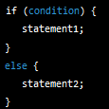
Grammar of a programming language
Definition (Grammar of a programming language):
The grammar of a programming language refers to a set of rules that define the syntax and structure of the language.
The grammar specifies how different components of the language, such as keywords, identifiers, operators, and expressions, can be combined to form valid programs.
For instance, the expected grammar or structure for an “if” statement is:

Slide 29

Grammar of a programming language
Definition (Grammar of a programming language):
The grammar of a programming language refers to a set of rules that define the syntax and structure of the language.
The grammar specifies how different components of the language, such as keywords, identifiers, operators, and expressions, can be combined to form valid programs.
In practice, we will check that the grammar follows a set of rules using context-free grammars (CFGs).
It consists of a set of rules, which describe how different elements of the language can be combined to form valid statements or expressions.

Slide 30
Syntax Analysis
Definition (Syntax Analysis):
Syntax Analysis, or parsing, is the second stage in the compilation process, after lexical analysis.
It involves analysing the structure of a program or source code to determine whether it conforms to the grammar of the source programming language (i.e. the set of rules and syntax).
In this stage, the compiler takes the series of tokens generated during the lexical analysis or tokenization stage.
It then attempts to build a parse tree (or syntax tree), which represents the structure and meaning of the program.

Slide 31
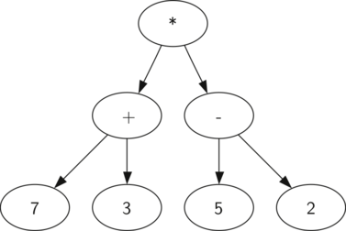

Parse Tree
Definition (Parse Tree):
The parse tree is a hierarchical structure, with nodes representing different parts of the program and their relationships to each other.
The root of the tree represents the entire program, and the child nodes represent the different components of the program, such as functions, loops, and conditionals.
Each node in the tree has a label or type that identifies its role and meaning in the program.

Slide 32
Syntax Analysis and Syntax Errors
Syntax analysis can also involve the detection and reporting of syntax errors, which are violations of the language rules.
When the compiler encounters a syntax error in the program, it stops the compilation process and generates an error message that identifies the location and nature of the error.
Syntax errors will typically include missing or incorrect punctuation, incorrect use of keywords or identifiers, wrong uses of conditional structures and loops, wrong sequences of tokens, or mismatched parentheses or braces.
(More on this on our lecture on CFGs and the lab activity!)

Slide 33
Syntax Analysis Recap
Syntax analysis allows the compiler to understand the structure and meaning of the program at a deep level.
By building a parse tree, the compiler can identify the different tokens of the program and their relationships to each other.
It then breaks down all the operations in the source code, into a set of elementary operations that the CPU could run.
Once the syntax analysis stage is complete, the compiler passes the parse tree or syntax tree to the next stage of the compilation process, the semantic analysis.

Slide 34
Semantic Analysis
Definition (Semantic Analysis):
Semantic Analysis is the third major phase of the front-end part of the compilation process, following the lexical and the syntax analysis.
The goal of semantic analysis is to ensure that the program is not only lexically and syntactically correct, but also semantically meaningful and free of errors.
For instance, this involves analysing the meaning of the program's statements and expressions and checking them against the rules and constraints of the language's type system and semantics.

Slide 35
Semantic Analysis Steps
The semantic analysis phase typically involves three important subtasks (there are more, but these are the main ones), which are:
Type checking,
Scope analysis,
And name resolution.
These tasks are performed in order to ensure that the program is well-formed and executable, before we attempt the translation process.
Each of these subtasks also serve to catch the final possible errors and inconsistencies that might cause the program to behave incorrectly or unpredictably at runtime. After this phase, the code to be compiled can be deemed “legal”, and the translation process can begin.

Slide 36
Type Checking
Definition (Type Checking):
Type Checking involves verifying that the types of the operands and operators in expressions are compatible and consistent with the rules of the language's type system.
For instance, in C and Python, adding two integers is a valid operation, but adding an integer and a string is not.
The type checker therefore ensures that the types of the operands in expressions match the expected types, and that the result of the expression is also of the correct type.

Slide 37
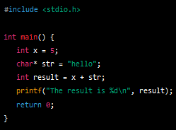
Type Checking
Definition (Type Checking):
Type Checking involves verifying that the types of the operands and operators in expressions are compatible and consistent with the rules of the language's type system.
For instance, in C and Python, adding two integers is a valid operation, but adding an integer and a string is not.
The type checker therefore ensures that the types of the operands in expressions match the expected types, and that the result of the expression is also of the correct type.

Slide 38
Scope Analysis
Definition (Scope Analysis):
Scope Analysis involves determining the visibility and accessibility of variables and other program elements, based on their declaration and context within the program.
This ensures that variables are only used in the correct context, and that they are not accidentally overwritten or used in unintended ways.
For instance: in most languages, if a variable is declared inside a function, it should only be accessible within that function and not outside of it.

Slide 39
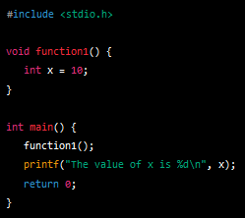
Scope Analysis
Definition (Scope Analysis):
Scope Analysis involves determining the visibility and accessibility of variables and other program elements, based on their declaration and context within the program.
This ensures that variables are only used in the correct context, and that they are not accidentally overwritten or used in unintended ways.
For instance: in most languages, if a variable is declared inside a function, it should only be accessible within that function and not outside of it.

Slide 40
Name Resolution
Definition (Name Resolution):
Name Resolution involves resolving references to variables, functions, and other program elements, based on their names and context within the program.
This ensures that the correct element is referred to, and that conflicts or ambiguities between different program elements are resolved correctly.
For instance, your code could have two variables with name “x” in two different functions, but the program should understand the difference between the two.

Slide 41
Semantic Analysis Recap
Overall, semantic analysis is an important part of the compilation process that ensures that programs are more than just lexically and syntactically correct.
By analysing the meaning and structure of the program's statements and expressions, semantic analysis helps to catch errors and inconsistencies that might cause the program to behave incorrectly or unpredictably at runtime.
This is the final step of the analysis part of the compiler: a source code that passes all three analysis steps is deemed legal, well-formed and will execute!

Slide 42
Quiz
What is the purpose of a compiler?
To translate a program written in one language into a program written in another language
To execute a program on a computer
To debug a program
To document a program

Slide 43
Quiz
What is the purpose of a compiler?
To translate a program written in one language into a program written in another language
To execute a program on a computer
To debug a program
To document a program

Slide 44
Quiz
What are types of compilers?
Source-to-source, just-in-time (JIT)
Front-end, middle-end, back-end
Syntax, semantics, tokens, parse tree, intermediate code, machine code, executable code
C, C++, Java, Python

Slide 45
Quiz
What are types of compilers?
Source-to-source, just-in-time (JIT)
Front-end, middle-end, back-end
Syntax, semantics, tokens, parse tree, intermediate code, machine code, executable code
C, C++, Java, Python

Slide 46
Quiz
Which of these operations are part of the front-end of a compiler?
Generating machine code
Optimizing code
Parsing source code and building an abstract syntax tree
Executing the code and showing error messages to the user, if any.

Slide 47
Quiz
Which of these operations are part of the front-end of a compiler?
Generating machine code
Optimizing code
Parsing source code and building an abstract syntax tree
Executing the code and showing error messages to the user, if any

Slide 48
Quiz
What are tokens in the context of a compiler?
The basic building blocks of the programming language's syntax
The abstract representation of the program's semantics
The set of instructions that a computer can execute directly
The high-level language that a program is written in

Slide 49
Quiz
What are tokens in the context of a compiler?
The basic building blocks of the programming language's syntax
The abstract representation of the program's semantics
The set of instructions that a computer can execute directly
The high-level language that a program is written in

Slide 50
Quiz
What is the parse tree?
A list of keywords and symbols used in the program
A data structure that represents the hierarchical structure of the source code
A set of rules that define the syntax of the programming language
A set of instructions that a computer can execute directly

Slide 51
Quiz
What is the parse tree?
A list of keywords and symbols used in the program
A data structure that represents the hierarchical structure of the source code
A set of rules that define the syntax of the programming language
A set of instructions that a computer can execute directly

Slide 52
Quiz
Which of these problems will be ignored by the lexical analysis and the syntax analysis, but caught be the semantic analysis?
A code contains a variable name, immediately followed by an integer value of some sort (e.g. “int x 10;”)
A code contains a special symbol, which has no meaning in the language (e.g. “int x = 10 @ 7;)
A code attempts to sum together two arrays x and y to produce a third array z, even though it is forbidden to use z = x + y on this type of variables in C
A code attempts to print a variable that is not yet defined (e.g. a printf(“%d”, x) appears before “int x = 7;”)

Slide 53
Quiz
Which of these problems will be ignored by the lexical analysis and the syntax analysis, but caught be the semantic analysis?
A code contains a variable name, immediately followed by an integer value of some sort (e.g. “int x 10;”)
A code contains a special symbol, which has no meaning in the language (e.g. “int x = 10 @ 7;)
A code attempts to sum together two arrays x and y to produce a third array z, even though it is forbidden to use z = x + y on this type of variables in C
A code attempts to print a variable that is not yet defined (e.g. a printf(“%d”, x) appears before “int x = 7;”)

Slide 54
Quiz
Which of these problems will be ignored by the lexical analysis and the syntax analysis, but caught be the semantic analysis?
A code contains a variable name, immediately followed by an integer value of some sort (e.g. “int x 10;”) → Syntax Analysis
A code contains a special symbol, which has no meaning in the language (e.g. “int x = 10 @ 7;)
A code attempts to sum together two arrays x and y to produce a third array z, even though it is forbidden to use z = x + y on this type of variables in C
A code attempts to print a variable that is not yet defined (e.g. a printf(“%d”, x) appears before “int x = 7;”)

Slide 55
Quiz
Which of these problems will be ignored by the lexical analysis and the syntax analysis, but caught be the semantic analysis?
A code contains a variable name, immediately followed by an integer value of some sort (e.g. “int x 10;”) → Syntax Analysis
A code contains a special symbol, which has no meaning in the language (e.g. “int x = 10 @ 7;) → Lexical Analysis
A code attempts to sum together two arrays x and y to produce a third array z, even though it is forbidden to use z = x + y on this type of variables in C
A code attempts to print a variable that is not yet defined (e.g. a printf(“%d”, x) appears before “int x = 7;”)

Slide 56
Quiz
Which of these problems will be ignored by the lexical analysis and the syntax analysis, but caught be the semantic analysis?
A code contains a variable name, immediately followed by an integer value of some sort (e.g. “int x 10;”) → Syntax Analysis
A code contains a special symbol, which has no meaning in the language (e.g. “int x = 10 @ 7;) → Lexical Analysis
A code attempts to sum together two arrays x and y to produce a third array z, even though it is forbidden to use z = x + y on this type of variables in C → Semantic Analysis, but careful, this operation could be allowed in some languages!
A code attempts to print a variable that is not yet defined (e.g. a printf(“%d”, x) appears before “int x = 7;”) → Semantic Analysis

Slide 57
The middle-end of a compiler
Definition (The middle-end part of a compiler):
The middle-end of a compiler follows the front-end analysis and it consists of a series of operations and transformations to optimize and improve its efficiency.
It involves tasks, such as:
Intermediate code generation
Code optimization,
and Data-flow analysis.

Slide 58
Intermediate code generation
Definition (Intermediate code generation):
Intermediate code generation is the process of transforming the source code into a code that is more abstract and closer to machine language, but not machine language just yet.
It is a much-needed step as making a direct jump from source code to target code might prove difficult.
Intermediate code
Source code
Target code

Slide 59
Intermediate code generation
Definition (Intermediate code generation):
Intermediate code generation is the process of transforming the source code into a code that is more abstract and closer to machine language, but not machine language just yet.
It is a much-needed step as making a direct jump from source code to target code might prove difficult.
In fact, an intermediate code representation is often easier to manipulate and allows for optimization.
The intermediate code is not specific to any particular hardware or operating system and can be easily transformed into the final machine code during the backend phase of the compilation process.

Slide 60
Intermediate code representations
Definition (intermediate code representations):
The intermediate code generated during this phase is often represented in a language that is easier to manipulate than the original source code.
Three-address code representations are typical examples of intermediate code representation languages that we will investigate.
Other representations exist, but will not necessarily be covered:
Virtual machine code,
Abstract syntax trees,
Etc.

Slide 61
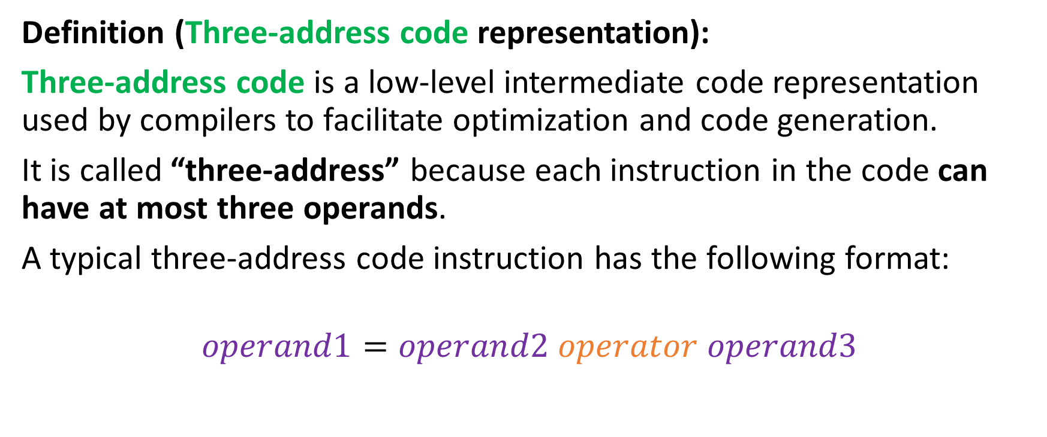
Three-address code representation
Definition (Three-address code representation):
Three-address code is a low-level intermediate code representation used by compilers to facilitate optimization and code generation.
It is called “three-address” because each instruction in the code can have at most three operands.
A typical three-address code instruction has the following format:
$$operand1=operand2 operator operand3$$

Slide 62
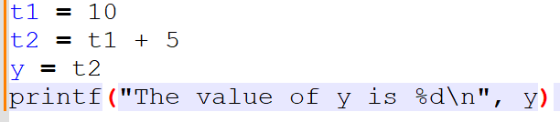
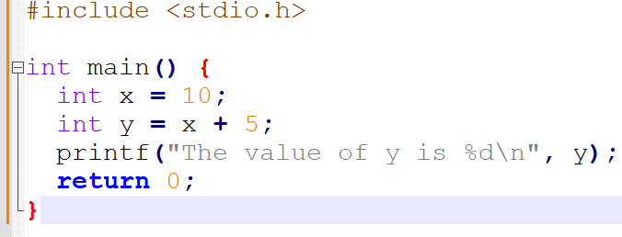
Three-address code representation
For instance, the C code below can be transformed…
…into its equivalent three-address code representation.

Slide 63
The back-end of a compiler
Definition (The back-end part of a compiler):
The back-end of a compiler takes the optimized and transformed code generated by the middle-end and translates it into machine code that can be executed.
It involves tasks, such as:
Instruction selection/ordering,
Register allocation,
and Code generation/optimization.

Slide 64
Code generation
Definition (code generation):
The code generation phase is responsible for generating machine code based on the intermediate code representation of the program produced by the middle-end part of the compiler.
This involves translating the intermediate representation into a low-level machine language that can be executed by the CPU (or GPU!).
In its most advanced versions, the code generator must take into account the specifics of the target architecture, such as the instruction set, memory hierarchy, and addressing modes.
And then, after the machine code is ready, we execute it, as explained in 50.002 Computation Structures!

Slide 65
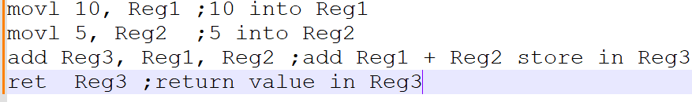
Recall your machine code from 50.002!
The machine code, to be executed by the CPU has
Decomposed the source code into basic instructions understandable by the CPU (or GPU),
Identified registers to use to store (and free) variables for each of these operations.
Need a refresher? Have a look at your 50.002 Computation Structures!

Slide 66
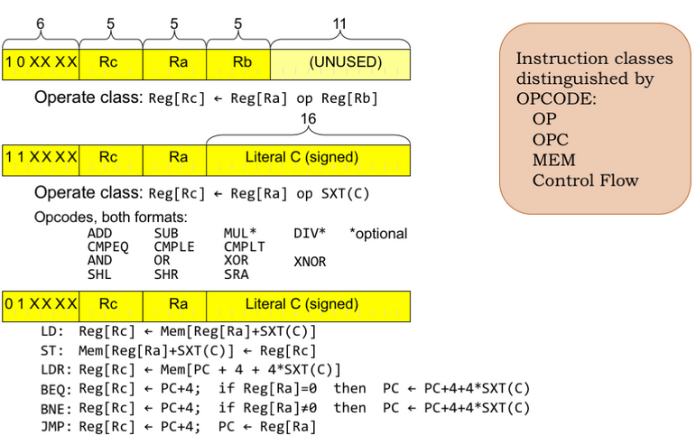
Recall your machine code from 50.002!
The machine code, to be executed by the CPU has
Decomposed the source code into basic instructions understandable by the CPU (or GPU),
Identified registers to use to store (and free) variables for each of these operations.
Need a refresher? Have a look at your 50.002 Computation Structures!

Slide 67
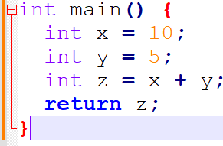
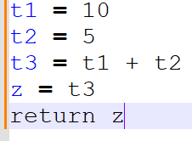
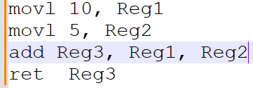
Source code (C)
Front-end
Lexical Analysis Syntax Analysis Semantic Analysis
After front-end, intermediate code (Three-address) and optimizations
Machine instructions after code generation and execution

Slide 68
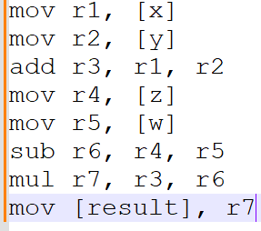
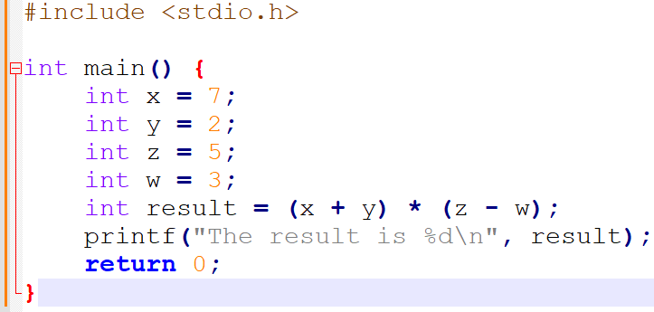
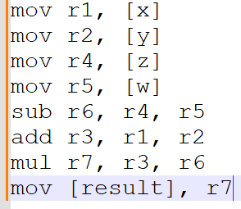
Instruction Ordering/Scheduling
These two are equivalent but prove that there might be scenarios where reordering instructions could prove beneficial!

Slide 69
Instruction Ordering/Scheduling
Definition (Instruction Ordering/Scheduling):
The instruction ordering (or scheduling) phase is responsible for rearranging the order of instructions in the program to improve performance.
This typically involves reordering instructions to take advantage of the parallelism and pipelining features of modern processors (with many cores running in parallel, for instance).
The instruction scheduler takes into account the dependencies between instructions and the specific features of the processor.
(Too advanced, could have been interesting, but out-of-scope).

Slide 70
Code optimization
Definition (Code optimization):
Code optimization is a critical process that involves analysing and modifying the intermediate code to make it run faster and consume fewer resources. Some of the optimizations typically include:
Dead code elimination: identify and remove dead code that is not executed during program execution. This allows to reduce the size of the final compiled code.

Slide 71
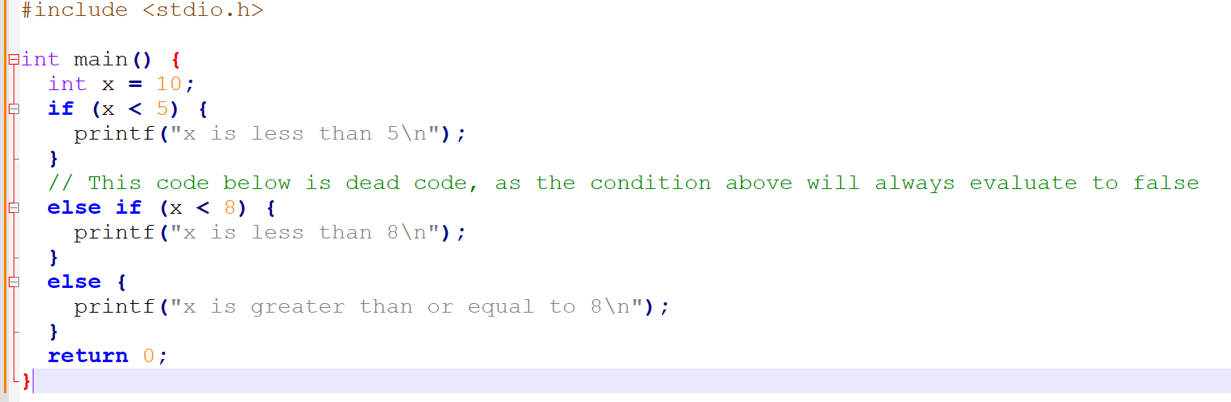
Dead code
Definition (dead code):
Dead code is code that is never executed during the runtime of a program, often following from bad code logic or design.

Slide 72
Dead code
Question: Can you see why the code shown on the right is containing some dead code?

Slide 73
Dead code
Answer: The else if statement is the dead code, as the preceding if statement will always evaluate to false since x is initialized to 10.

Slide 74
Code optimization
Definition (Code optimization):
Code optimization is a critical process that involves analysing and modifying the intermediate code to make it run faster and consume fewer resources. Some of the optimizations typically include:
Constant folding: replace multiple expressions that involve constant values with their computed values. This allows to reduce the number of computations performed during program execution.

Slide 75
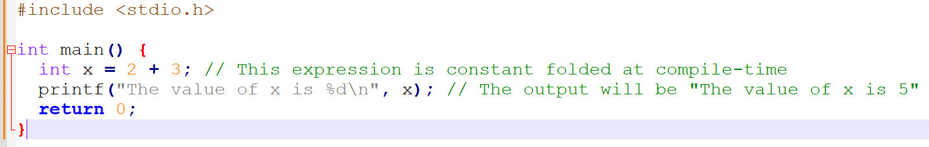
Constant folding
As an example of constant folding…
In the code below, the expression x = 2 + 3 can be folded into a simpler expression x = 5 during compilation, eliminating the need to perform the addition operation at runtime.

Slide 76
Code optimization
Definition (Code optimization):
Code optimization is a critical process that involves analysing and modifying the intermediate code to make it run faster and consume fewer resources. Some of the optimizations typically include:
Control flow optimization: optimize the instructions and the order of instructions being executed. This allows, for instance, to reduce the number of necessary branch instructions, removing parts that could almost be considered dead code (even though they did not follow from bad logic this time).

Slide 77
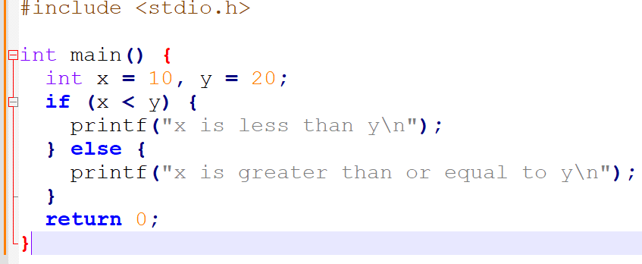
Control flow optimization
As an example of control flow optimization…
The program below uses an if-else statement to check if the value of x is less than the value of y.

Slide 78
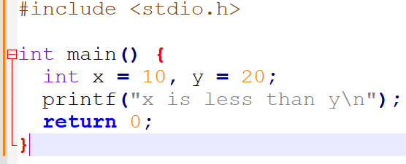
Control flow optimization
As an example of control flow optimization…
The program below uses an if-else statement to check if the value of x is less than the value of y.
Control flow optimization analyses the code and can determine that x will always be less than y, as they are constants.
It can simplify the code to eliminate the unnecessary if-else statement and simplify the code even further.

Slide 79
Code optimization
Definition (Code optimization):
Code optimization is a critical process that involves analysing and modifying the intermediate code to make it run faster and consume fewer resources. Some of the optimizations typically include:
Dead code elimination,
Constant folding,
Control flow optimization,
Many other operations: Function Inlining (substituting secondary functions into main), Loop Unrolling (replaces a loop with a fixed number of iterations with a series of unrolled iterations), etc.

Slide 80
Register Allocation
Definition (Register Allocation):
During the register allocation phase, the compiler assigns program variables to the different types of memories, in an efficient way.
As seen in 50.002 Computation Structures, this is important because CPU registers are much faster than other types of memory, but are very limited in numbers (a.k.a memory hierarchy).
The register allocator must take into account the constraints imposed by the CPU architecture, such as the number and type of available registers, but also identify in the code variable that are used many times to give them priority in terms of memory space.
(Could have been interesting, but probably out-of-scope).

Slide 81
The architecture of a compiler
Definition (the three parts of a typical compiler architecture):
A typical compiler architecture consists of three main components: the front-end, middle-end, and back-end.
Each component is responsible for a specific set of tasks and works together to generate the final executable code.
Hopefully, this gives us a roadmap!

Slide 82
Quiz
What is the middle-end phase of a compiler?
The phase that analyses and optimizes an abstract syntax tree or another intermediate code representation.
The phase that generates machine code from the intermediate representation (IR) code.
The phase that performs lexical analysis and tokenization of the source code.
The phase that performs typos checking and reporting.

Slide 83
Quiz
What is the middle-end phase of a compiler?
The phase that analyses and optimizes an abstract syntax tree or another intermediate code representation.
The phase that generates machine code from the intermediate representation (IR) code.
The phase that performs lexical analysis and tokenization of the source code.
The phase that performs typos checking and reporting.

Slide 84
Quiz
What is the purpose of instruction selection in a compiler?
To perform static analysis of the program to identify possible runtime errors.
To generate an optimized intermediate representation (IR) that can be used for code generation.
To map high-level or intermediate-level language constructs to low-level machine instructions that can be executed by the processor.
To optimize the code for specific target architectures and instruction sets.

Slide 85
Quiz
What is the purpose of instruction selection in a compiler?
To perform static analysis of the program to identify possible runtime errors.
To generate an optimized intermediate representation (IR) that can be used for code generation.
To map high-level or intermediate-level language constructs to low-level machine instructions that can be executed by the processor.
To optimize the code for specific target architectures and instruction sets.

Slide 86
Quiz
What is register allocation in a compiler?
The process of mapping variables to their literal values.
The process of transforming high-level language constructs into low-level machine code.
The process of selecting the best set of machine instructions to implement a program.
The process of mapping variables to hardware registers in the target architecture (CPU or GPU).

Slide 87
Quiz
What is register allocation in a compiler?
The process of mapping variables to their literal values.
The process of transforming high-level language constructs into low-level machine code.
The process of selecting the best set of machine instructions to implement a program.
The process of mapping variables to hardware registers in the target architecture (CPU or GPU).

Slide 88
Quiz
The compiler is a computer program, and this program has necessarily been compiled at some point. Which language has then been used to write the C compiler?
HTML and PHP…!
A language older than C like Fortran?
C itself?!
Machine code only?!!?

Slide 89
Quiz
The compiler is a computer program, and this program has necessarily been compiled at some point. Which language has then been used to write the C compiler?
HTML and PHP (lol)
A language older than C like Fortran? C--? B?
C itself?!
Machine code only?!!?

Slide 90
Quiz
The compiler is a computer program, and this program has necessarily been compiled at some point. Which language has then been used to write the C compiler?
HTML and PHP (lol)
A language older than C like Fortran? C--? B? (Technically no, because it would not resolve the problem of which language was used to compile this compiler in Fortran then)
C itself?!
Machine code only?!!?

Slide 91
Quiz
The compiler is a computer program, and this program has necessarily been compiled at some point. Which language has then been used to write the C compiler?
HTML and PHP (lol)
A language older than C like Fortran? C--? B? (Technically no, because it would not resolve the problem of which language was used to compile this compiler in Fortran then)
C itself?!
Machine code only?!!?

Slide 92
Quiz
The compiler is a computer program, and this program has necessarily been compiled at some point. Which language has then been used to write the C compiler?
HTML and PHP (lol)
A language older than C like Fortran? C--? B? (Technically no, because it would not resolve the problem of which language was used to compile this compiler in Fortran then)
C itself?!
Machine code only?!!?

Slide 93
Bootstrapping
Definition (Bootstrapping):
The latest version of the C compiler is typically written in C itself.
The source code for latest version of the C compiler is then compiled using an older version of the compiler that is already available.
This process is called bootstrapping, and it allows a C compiler to be built from scratch by reusing and improving an existing compiler.
Once a basic C compiler is built, it can be used to compile other programs written in C, including newer versions of the C compiler itself with more advanced features.

Slide 94
Bootstrapping
Definition (Bootstrapping):
The latest version of the C compiler is typically written in C itself.
The source code for latest version of the C compiler is then compiled using an older version of the compiler that is already available.
This process is called bootstrapping, and it allows a C compiler to be built from scratch by reusing and improving an existing compiler.
Once a basic C compiler is built, it can be used to compile other programs written in C, including newer versions of the C compiler itself with more advanced features.
→ Ok, but then what was the language used for the “first” compiler?

Slide 95
The mother of all compilers
Ok, but then what was the language used for the “first” compiler?
The first C compiler was developed by Dennis Ritchie at Bell Labs in the early 1970s (this is the same person who invented the language).
The first C compiler was written in assembly language.
After that, every time a new version of the C compiler was needed, we would use bootstrapping.

Slide 96
The mother of all compilers
This “first” compiler had some very basic features:
It supported the basic features of the C language, including data types, control structures, and functions.
It produced assembly language code as output, which could be assembled into machine code using a separate assembler.
It used a simple two-pass compiler architecture, where the first pass performed lexical analysis and created a symbol table, and the second pass performed syntax analysis and code generation.
It included a rudimentary optimizer that performed simple optimizations such as constant folding and algebraic simplification.
It had a limited set of error messages and debugging capabilities, which made it difficult to diagnose and fix errors in the code.

Slide 97
The mother of all compilers
Despite its limitations, this “first” C compiler was a significant achievement because it allowed C to become a popular language for system programming and operating systems development.
The availability of a reliable and efficient C compiler helped to make C a popular choice for operating system development, as well as for writing other higher-level programming compilers/interpreters.
Learn more about Dennis Ritchie and his founding (and very much underrated) work on C and compilers: https://www.youtube.com/watch?v=g3jOJfrOknA

Slide 98
A bit of history on compilers
References and extra reading, if any (for those of you who are curious):
A bit of history of compilers https://www.geeksforgeeks.org/history-of-compiler/

Slide 99
Compilers: benefits and disadvantages
Benefits of compilers
Disadvantages of compilers
Performance: Compiled code is often faster and more efficient than interpreted code because it is translated into machine code beforehand. This leads to improved application performance, especially for computationally intensive tasks.
Optimizations: Compilers can perform complex optimizations that are difficult or impossible for interpreters to achieve (to be discussed later, e.g. loop unrolling, function in-lining, and constant propagation).
Portability: Compiled code can be packaged into standalone executable files, making it easier to distribute and run on different platforms.
Development time: Compilers require a separate compilation step before the code can be executed. In addition, code will only compile if flawless. This can make development and testing more difficult and less beginner-friendly.
Memory management: Some compiled languages may require more complex memory management, which can be challenging for novice programmers.
Platform-specific code: Compilers can generate machine code that is specific to the platform it is compiled on, which can limit portability across different platforms.

Slide 100
Interpreters: benefits and disadvantages
Benefits of interpreters
Disadvantages of interpreters
Interactivity: Interpreters allow for greater interactivity during the development process, because changes to the code can be seen immediately without the need for a separate compilation step.
Flexibility: Interpreters are more flexible than compilers because they can interpret code on-the-fly, allowing for greater dynamic behavior and runtime adaptability.
Ease of debugging: Because interpreters execute their code line-by-line, it is often easier to debug code in an interpreter than in a compiler.
Performance: Interpreted code is often slower and less efficient than compiled code because it is translated into machine code on-the-fly during execution.
Limited optimizations: Interpreters can perform limited optimizations and may not be able to achieve the same level of performance optimizations as a compiler.
Lack of portability: Interpreted code often requires a specific interpreter to run, which can limit portability across different platforms.

